Slide 1
Simulated Annealing The Travelling Salesman Problem
Guoyi Li

Slide 2
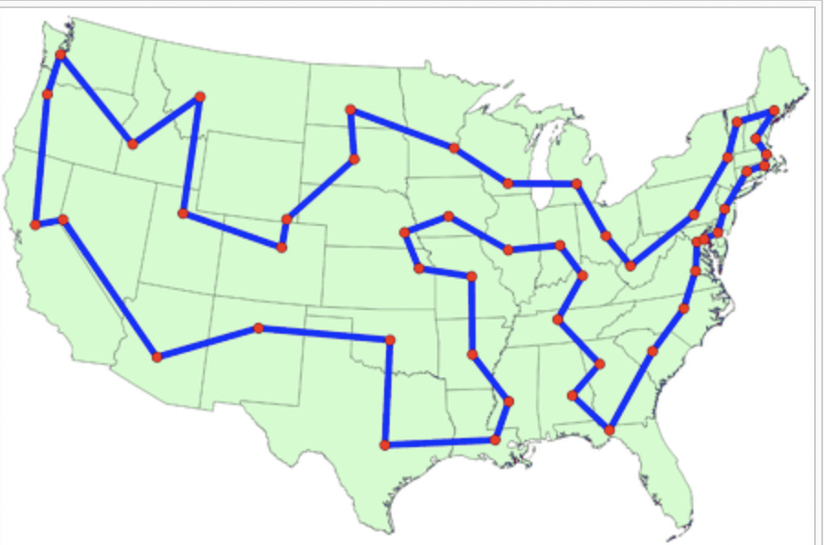
Background
Question:
“Given a list of cities and the distances between each pair of cities, what is the shortest possible route that visits each city exactly once and returns to the origin city?” ----Wikipedia
For solving this question:
Simulated Annealing

Slide 3
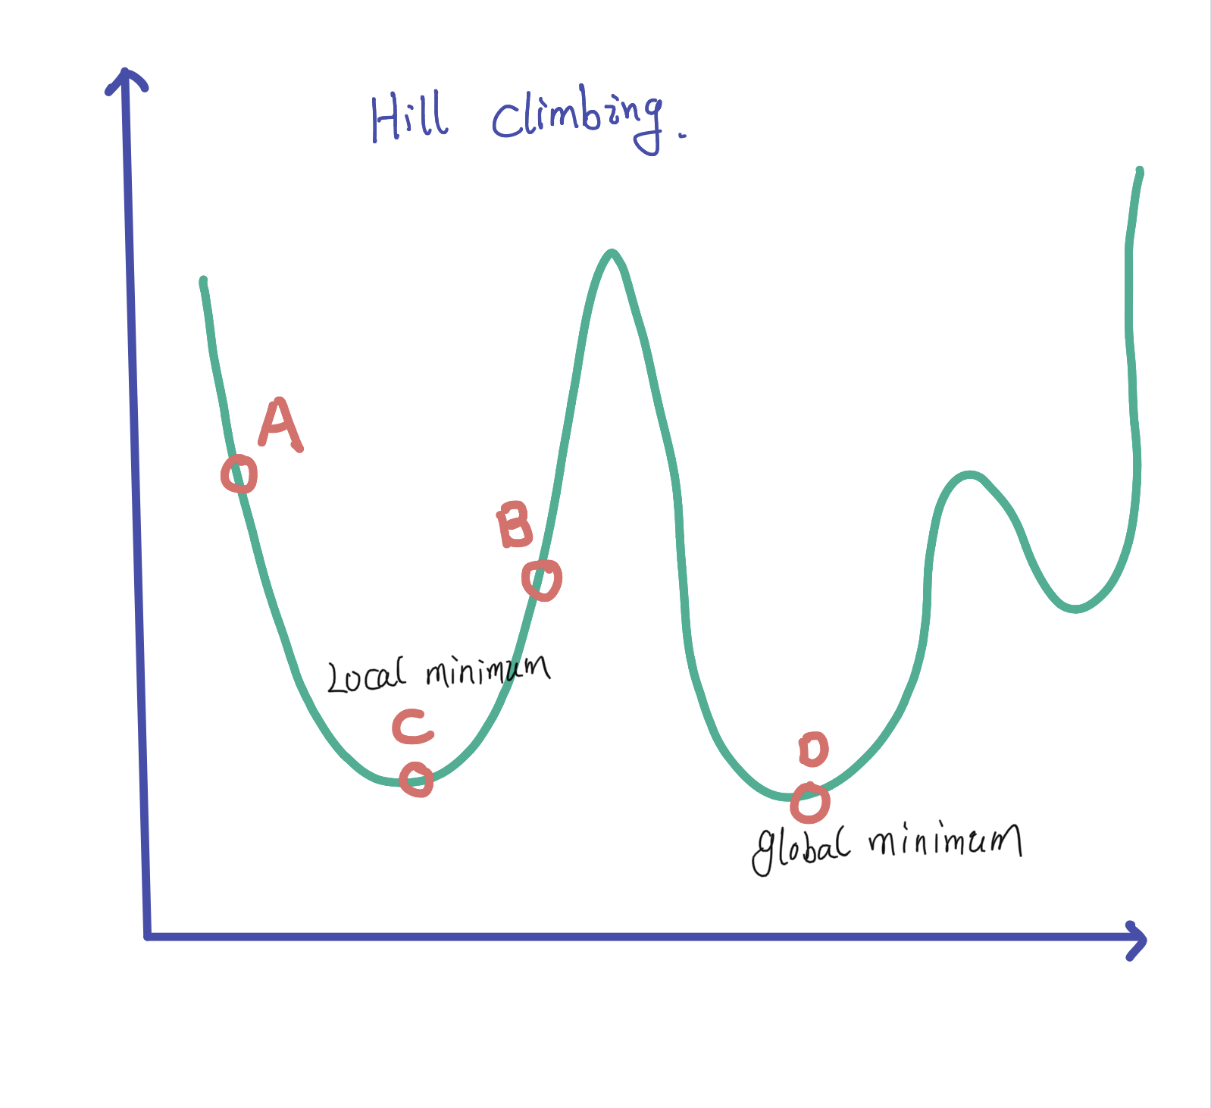
What is the Simulated Annealing
Hill Climbing
Definition: Hill climbing will not necessarily find the global maximum, but may instead converge on a local minimum
It is a greedy algorithm that only can help us to find the local minimum, without worried about the global minimum
On the graph, Even though D is global minimum, but we only care about the C.
If we can let Hill Climbing to jump around different Hills. Then we may be able to find D. That’s Simulated Annealing comes alone
Instead, Only going down one hill, why not try another hill.

Slide 4
Simulated Annealing
Temperature: 1000
Cities: 10
Value Range: 0 ~ 100
Temperature changed by 0.98 * Current_ Temperature

Slide 5
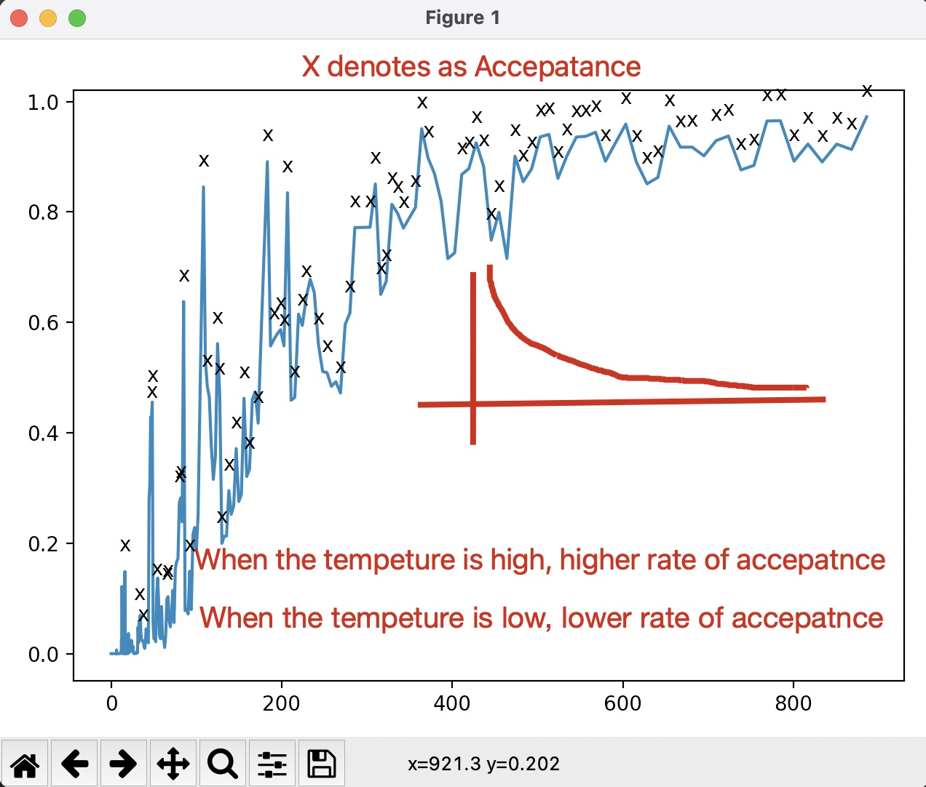

Understanding the Guessing process
The first important element: Temperature
$p\left[accept\left|f\left(x − △x\right)≥f\left(x\right)\right|\right]=exp⁡(\frac{f\left(x\right)−f\left(x+ △x\right)}{T})$
--- Lecture of “Stochastic Search”
Though: compared to the Hill Climbing, now Annealing
Schedule tried a lot of guess to jump around the hills.
However, Does it help us to get optimal solution?

Slide 6
Let’s start with fewer Cities
Within a few runes, it will quickly find a solution because it has fewer cities..
It is an optimal Solution!!

Slide 7
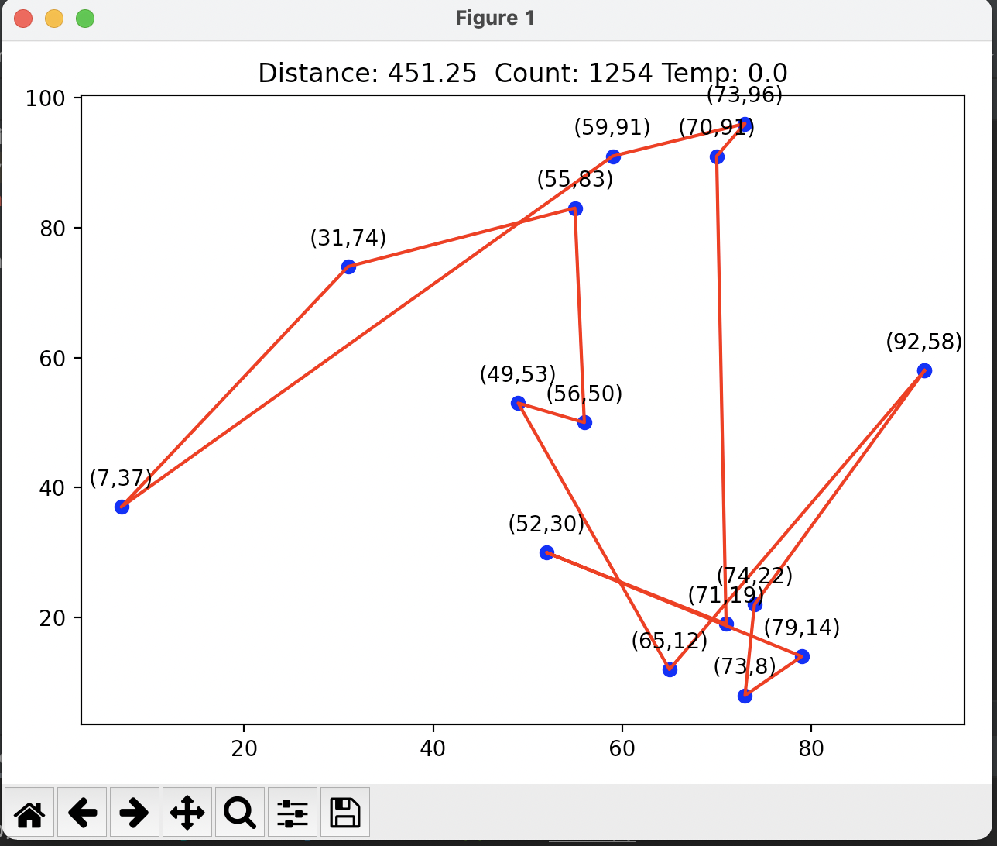
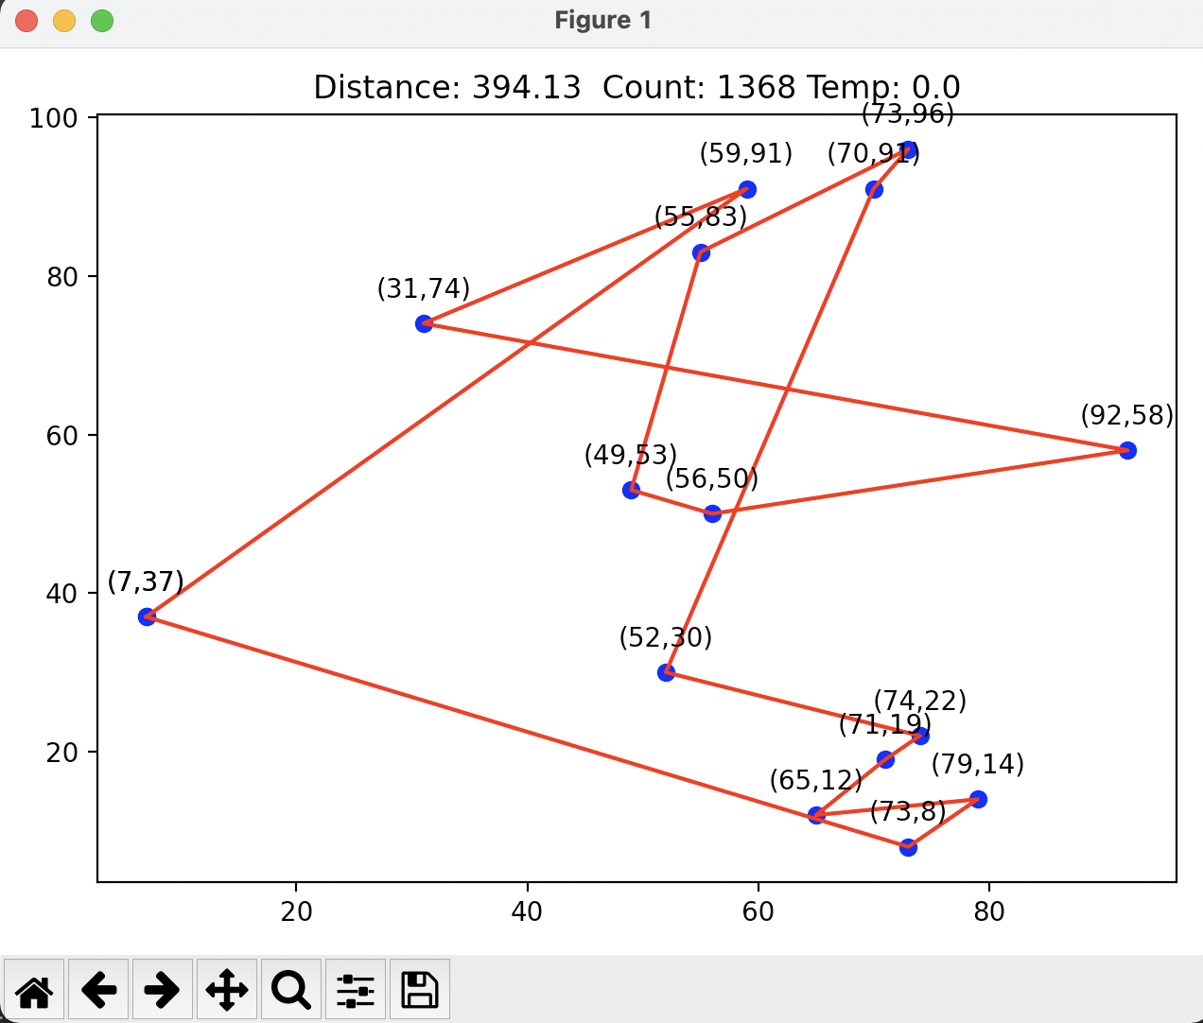
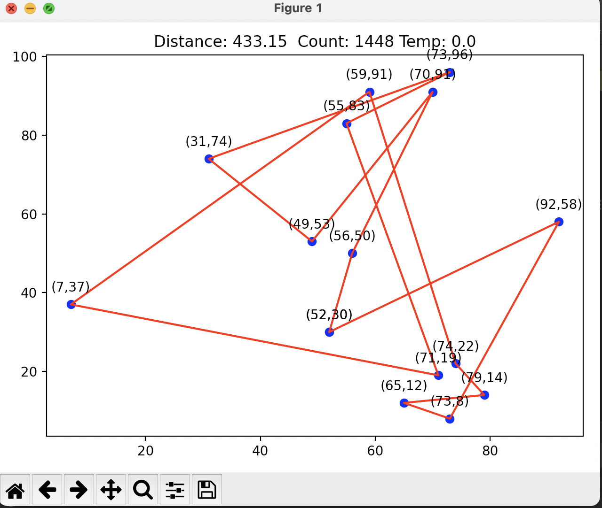
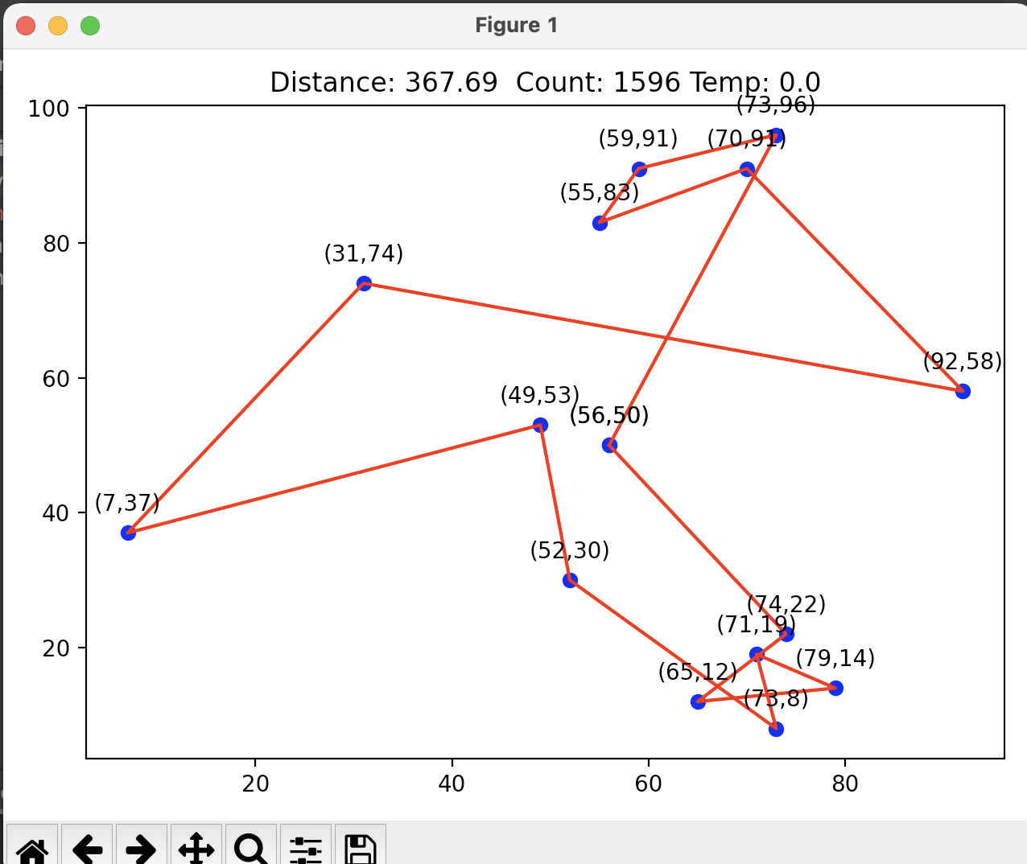
With more Cities
Temperature : 500
Cities : 15
Running Time : 84.5
Score : 433.15
Count. : 1448
Temperature : 1000
Cities : 15
Running Time : 91
Score : 367.86
Count. : 1596
Temperature : 10
Cities : 15
Running Time : 72.23
Score : 451
Count. : 1254
Temperature : 100
Cities : 15
Running Time : 79.76
Score : 394.12
Count. : 1368
Compared to 10 cities, 15 cities took much more time to find an optimal way
Higher Temperature may not be able to find more optimal path, but if it takes more chance to guess .
it eventually has higher score

Slide 8
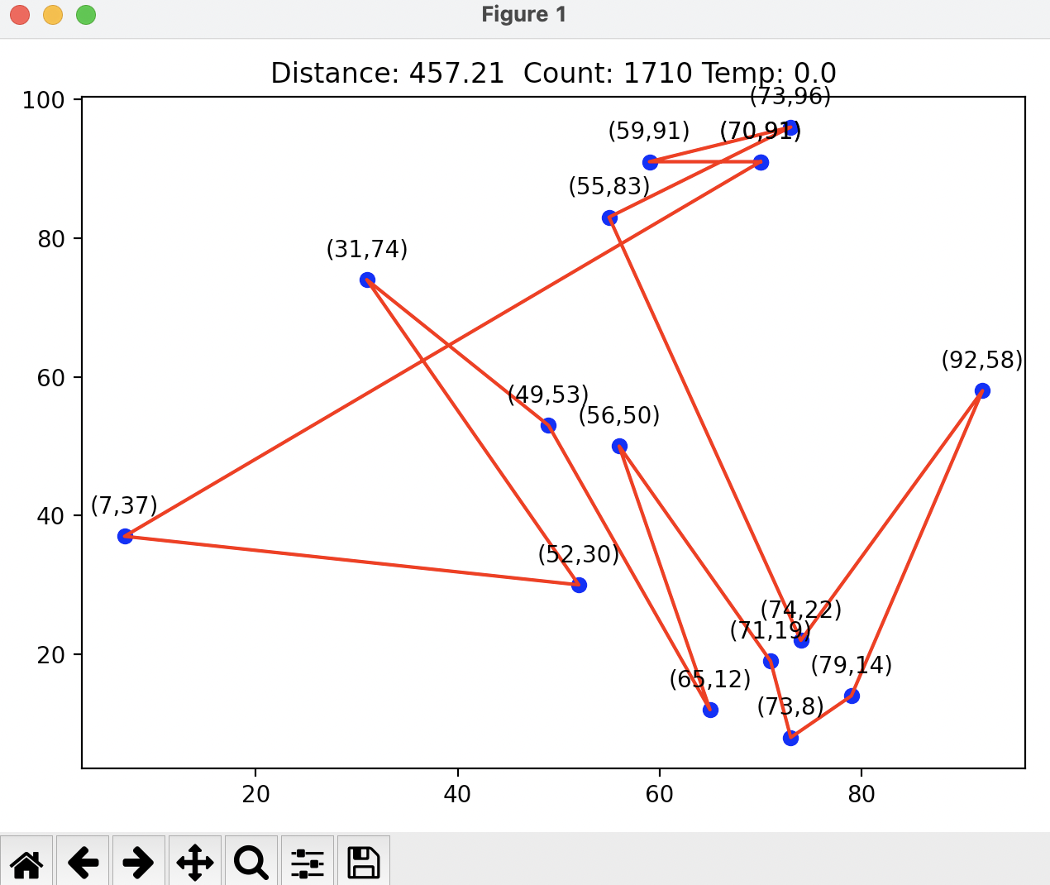
If we provide much more Temperature, slow down it as slower as we can.
When Temperature up to 10000, it took more steps, and tried more guess. It turns out a much nicer pictures!

Slide 9
Conclude
From the above processes, we can see that the simulated annealing algorithm is a random algorithm, it has a certain probability to find the global optimal solution.
If we do enough guesses and take enough steps. The simulated annealing algorithm can quickly find the optimal approximate solution of the problem. The key to it is to allow a certain error

